Slide 1
Welcome
To
MS Office

Slide 2


Introduction
MS Office is an Application software developed by Microsoft corporation USA . Microsoft was founded by Bill Gates and Paul Allen on 1975,
Microsoft Corporation, leading developer of personal-computer software systems and applications.
MS Office is mainly used for office work such as
Documentation
Worksheet
Presentation

Slide 3
Introduction
Microsoft Office is designed specifically for business and office use. It is a proprietary product of Microsoft Corporation and was first released in 1990.
MS Office has been a dominant model in delivering modern office-related document-handling software environments.
Microsoft Office is available in 35 different languages and is supported by Windows, Mac and most Linux variants.

Slide 4
Different Applications
Microsoft Word.
Microsoft Excel.
Microsoft PowerPoint.
Microsoft OneNote.
Microsoft Outlook.
Microsoft Publisher.
Microsoft Access.

Slide 5

MS Word
MS Word is a word processing software which is help to create, edit and alter documents as our requirements.
USEs Of MS Word
Office letters
Books
Resumes
Question Papers
Documents

Slide 6

How to Open MS Word
Start → All Programs → MS Office → MS Word.
Start → Run→ WinWord→ Enter ( Window + R)
Double Click on MS Word Icon :

Slide 7
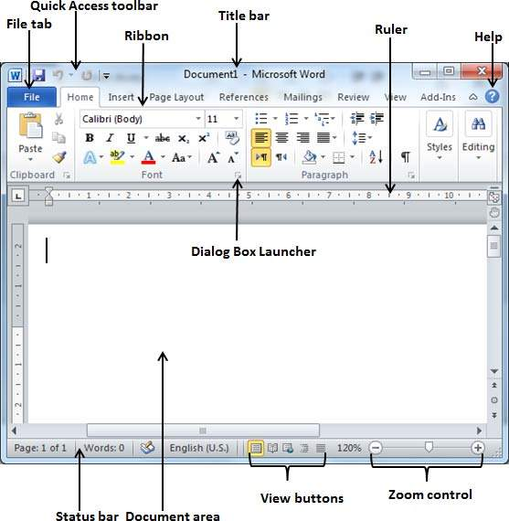
Window Screen

Slide 8
Tabs
Alt + F
Alt + H
Alt + N
Alt + P
Alt + S
Alt + M
Alt + R
Alt + w
Home
This has options like font colour, font size, font style, alignment, bullets, line spacing, etc.
Insert
Tables, shapes, images, charts, graphs, header, footer, page number, etc. can all be entered in the document. They are included in the “Insert” category.
Design
The template or the design in which you want your document to be created can be selected under the Design tab. Choosing an appropriate tab will enhance the appearance of your document.
Page Layout Under the Page Layout tab comes options like margins, orientation, columns, lines, indentation, spacing

Slide 9
Tabs
Alt + F
Alt + H
Alt + N
Alt + P
Alt + S
Alt + M
Alt + R
Alt + w
References
This tab is the most useful for those who are creating a thesis or writing books or lengthy documents. Options like citation, footnote, table of contents, caption, bibliography, Mailing
Envelope, Label and Letters we can create using mail merge option. Review
Spell check, grammar, Thesaurus, word count, language, translation, comments, etc. can all be tracked under the review tab.

Slide 10
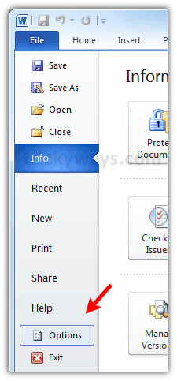
File Menu
Save : Ctrl + S = To save Our Documents
Save as : F12 = To make Same document in another name
Open : Ctrl + O = To open Save file / Doc
New : Ctrl + N = To take New Page
Print : Ctrl + P = To Print Documents
Print Preview = Before print check once as final copy

Slide 11
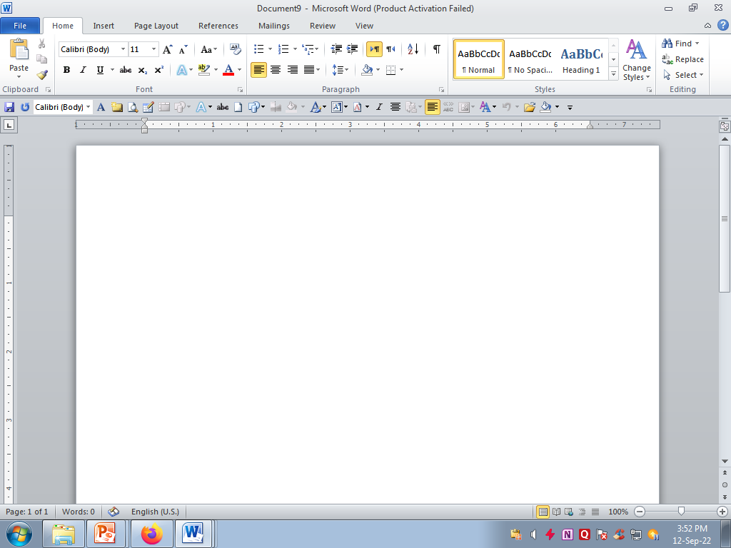
Home Tab
Clipboard | Font | Paragraph
CUT – Ctrl + X | Font Style [ Ctrl + Shift + F] | Bullets
Copy – Ctrl + C | Font Size -Ctrl + [ | Numbering
Paste – Ctrl + V | Increase Font - ctrl + shift + > | Line Spacing
 | Decrease Font - ctrl + shift + < | Indentation
 | Bold - Ctrl + B Italic - Ctrl + I Under Line - Ctrl + I Font Colour Change Case Clear Formatting Strikethrough highliter | Alignments Right - Ctrl + R Center - Ctrl + E Left - Ctrl + L Justify - Ctrl + J Paragraph

Slide 12
Cut : It Delete the content from location you can paste it another location
Copy : It create duplicate text or Objects
Paste : after cut or copy you should use paste option to insert text or objects which you make cut or copied.
Font Styles : It consists of pre defined text styles.
Font Size : Different text sizes we get here
Font Colour : to change the Font color of your text.
Bold: It allows you to Bold the text of your document
Italic: It allows you to Italicize the text of your document
Underline: It allows you to underline the text of your document

Slide 13
Sentence case: It capitalizes the first letter of each sentence.
Lowercase: It changes the text from uppercase to lowercase.
Uppercase: It capitalizes all the all letters of your text.
Capitalize Each Word: It capitalizes the first letter of each word.
Toggle Case: It allows you to shift between two case views,
Align Text Left: Aligns the text towards left margin – Ctrl +L
Center: Brings the text at center – Ctrl + E
Align Text Right: Aligns the text towards right margin - Ctrl + R
Justify: Aligns the text to both left and right margins – Ctrl - J

Slide 14
Insert Tab
Table 8. Hyperlink ( Ctrl + K) 15.Signature line
Picture 9. Bookmark 16. Date & Time
Clipart 10. Header & Footer 17.Objects
Shapes 11. Page number 18. Equation
SmartArt 12. Text box 19. Symbols
Chart 13. Word Art
Screenshot 14. Drop cap

Slide 15
Page layout
Themes 8. Watermark 14.Wrap text
Margins 9. Page color
Orientation 10. Page border
Size 11. Page number
Columns 12. Indent
Break 13. Spacing

Slide 16
References
Table of Contents
Add text
Update Table
Insert Citation
Manage source
Bibliography

Slide 17
Mailings
Envelopes
Labels
Start Mail merge
Select Recipients
Insert Merge fields
Finish Merge

Slide 18
Review
Spellings & Grammar – F7
Track changes
Restrict Editing
Protect document

Slide 19
View
Document Views 4) Zoom
Ruler 5) Window
Macros

